Slide 1

LAPD Crime Data Analysis (2010 - 2015)
Visualizing Crime Trends for Improved Policing
Presented by: Hernan Moratto, Gabrielle Meloncelli, Faranak Sadeghi and Maame Birago Aninkorah

Slide 2

Background of LAPD Crime Unit
Founded in 1869, LAPD is one of the largest U.S. police departments.
Responsibilities include crime prevention, law enforcement, and public safety.
Focus on community-oriented policing and data-driven strategies.

Slide 3

LAPD Mission and Vision
Mission: Safeguard lives and property, reduce crime, enhance public safety.
Vision: Trusted and innovative policing with integrity and transparency.

Slide 4

Dataset Overview
Source: LAPD Crime Dataset (2010 - 2015).
Includes: Date, Time, Area, Crime Type, Victim Info, Location, Status.
Covers: Over 1 million reported crimes across 5 years.

Slide 5

Data Cleaning Process
Removed duplicates and null values.
Standardized date/time formats and validated locations.
Grouped time into hourly buckets for analysis.
Cleaned demographic and weapon fields for consistency.

Slide 6
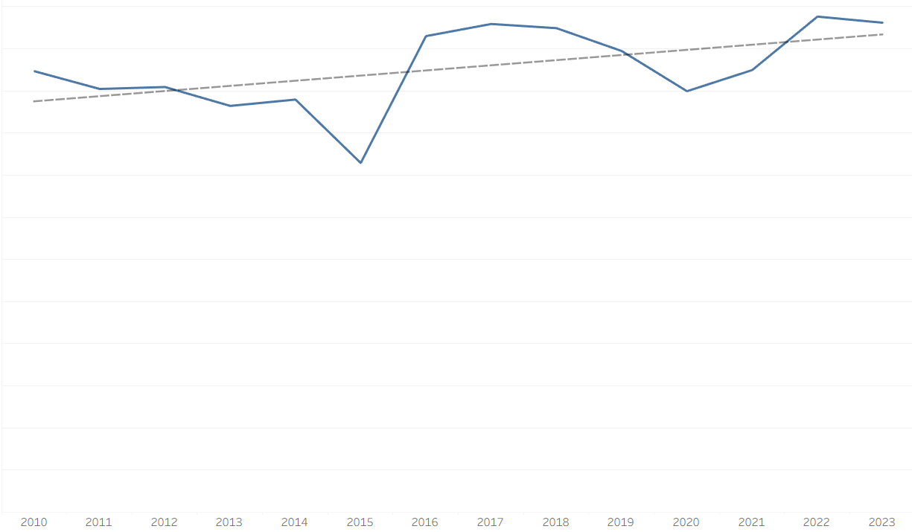
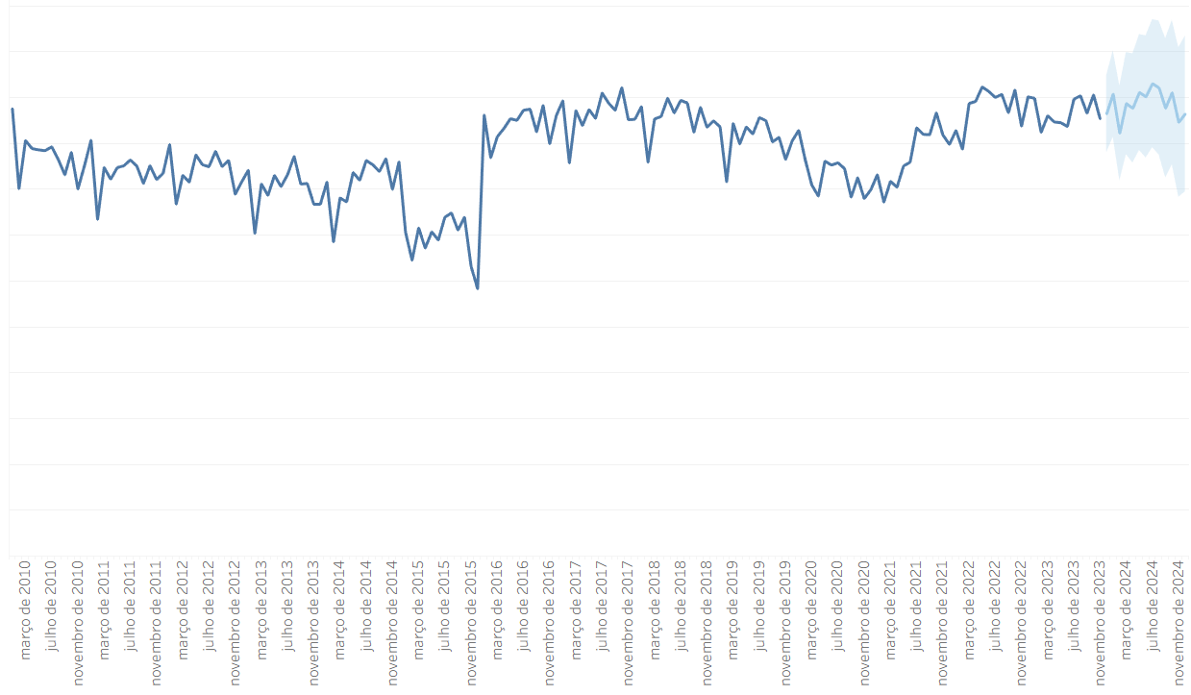
Crime Frequency Over Time

Slide 7
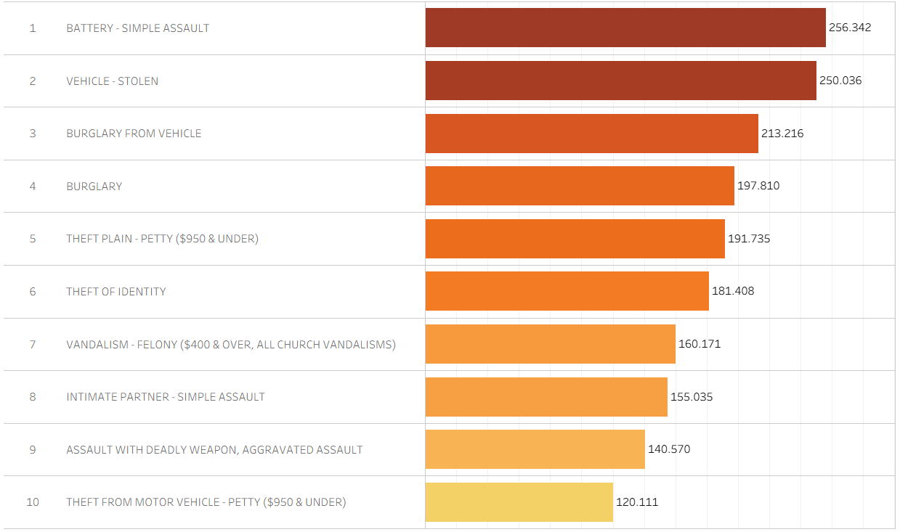
Top Crime Types

Slide 8
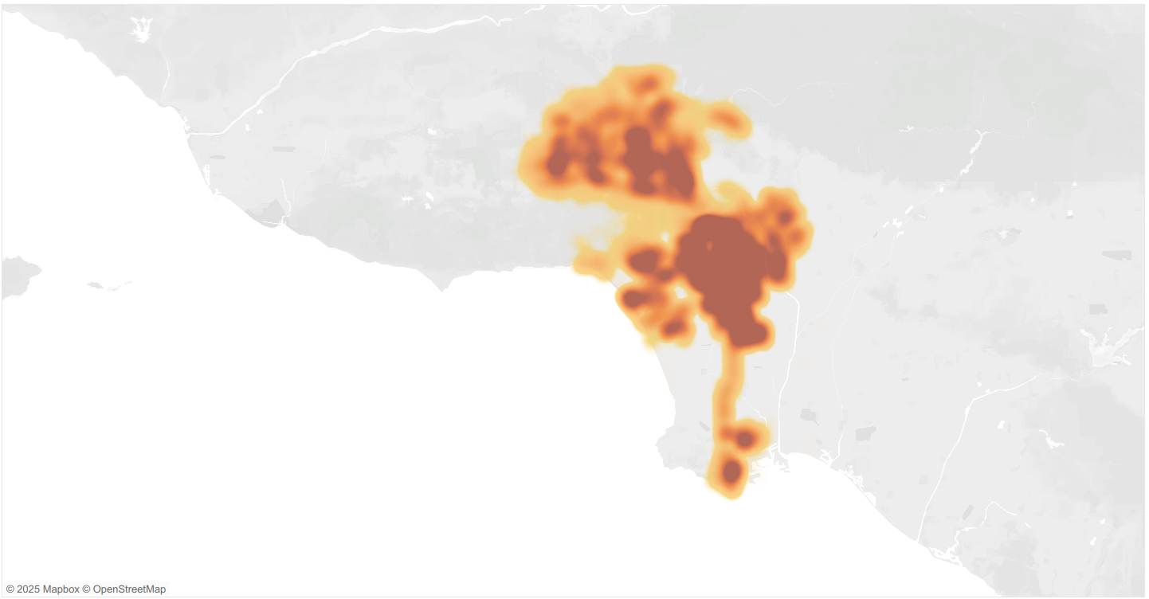
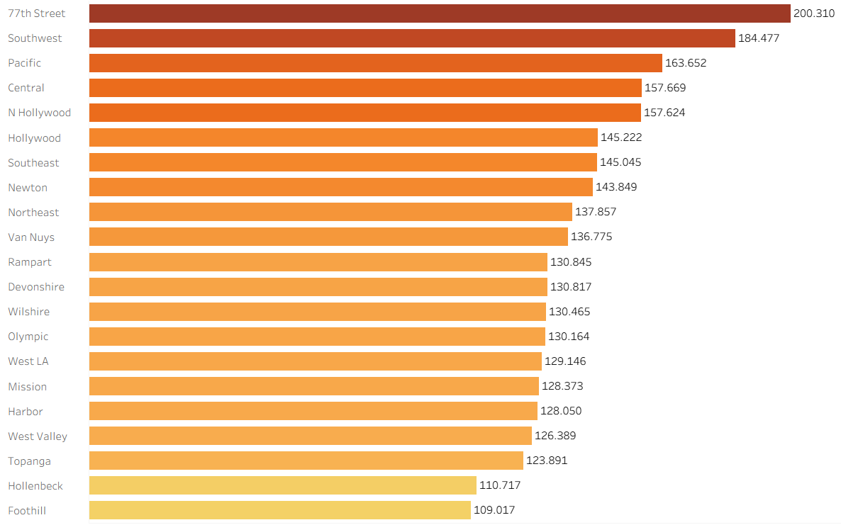
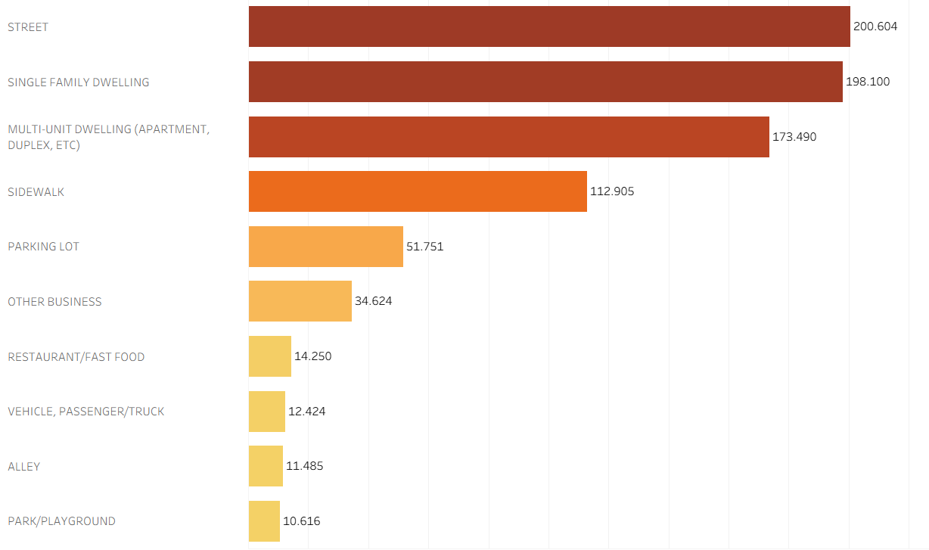
Crime Distribution by Area

Slide 9
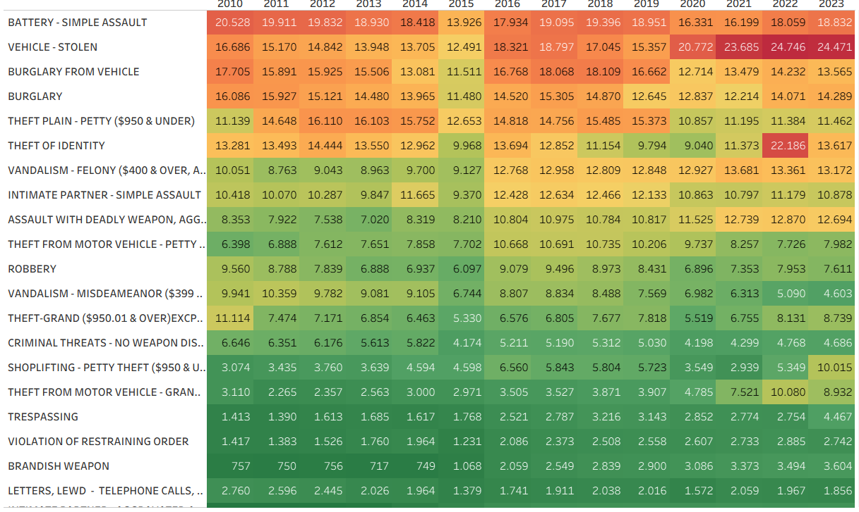
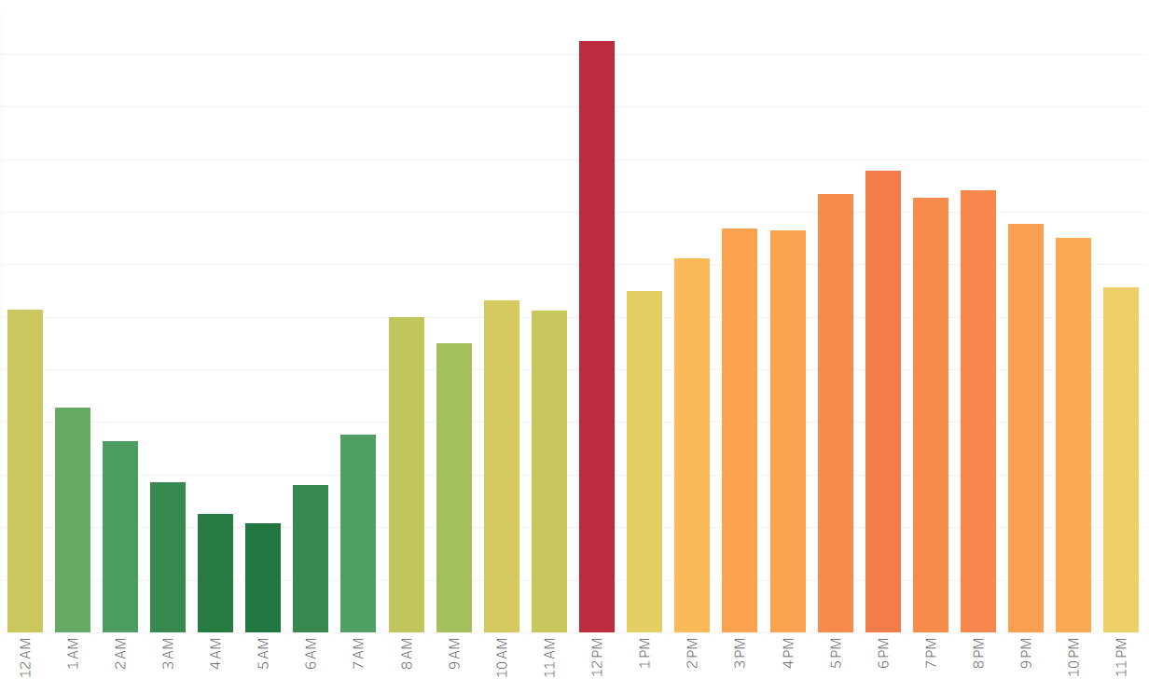
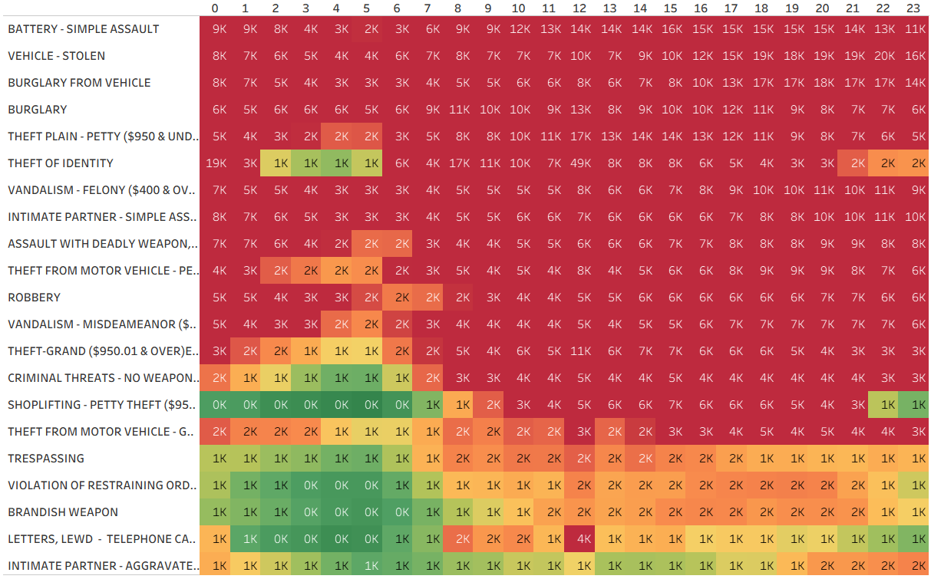
Time of Day vs Crime Type

Slide 10
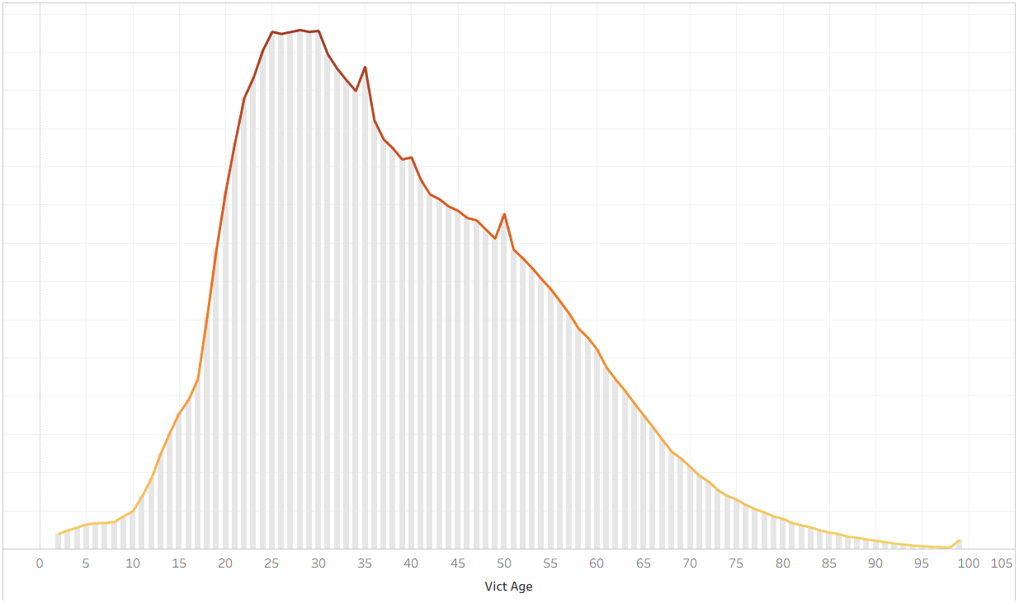
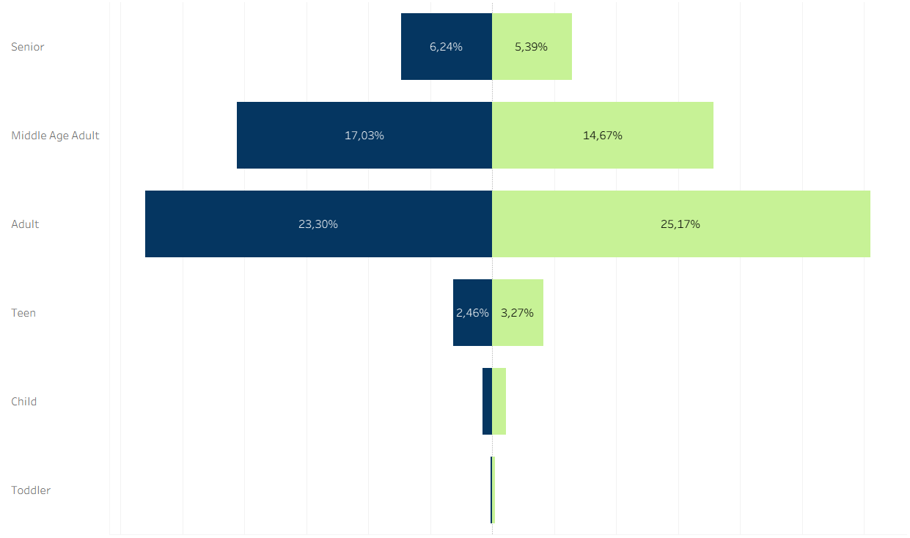
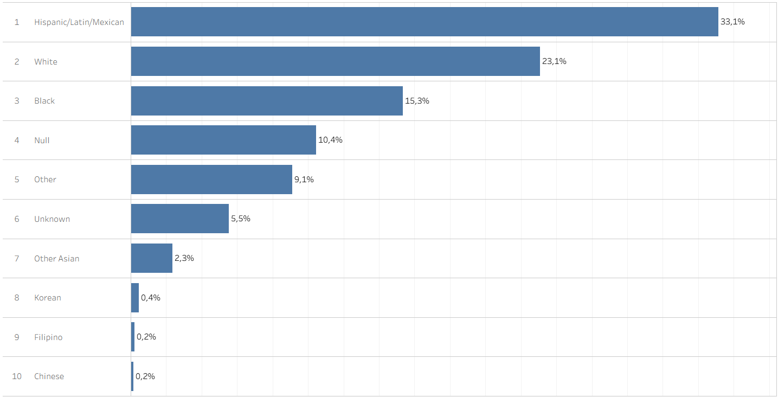
Victim Demographics

Slide 11
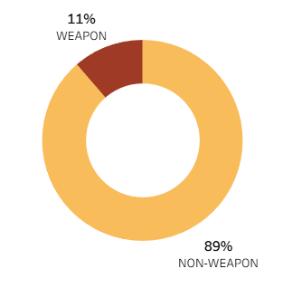
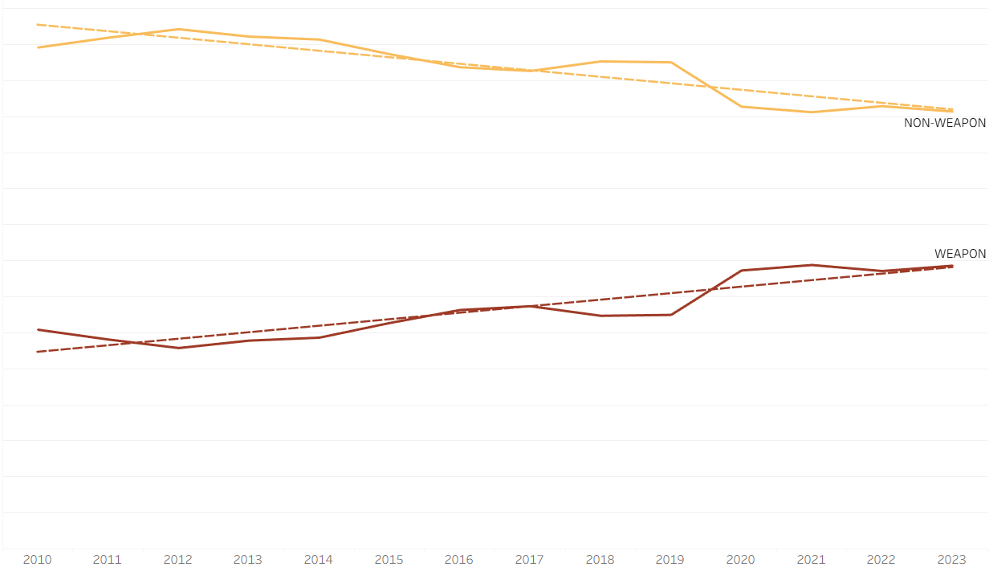
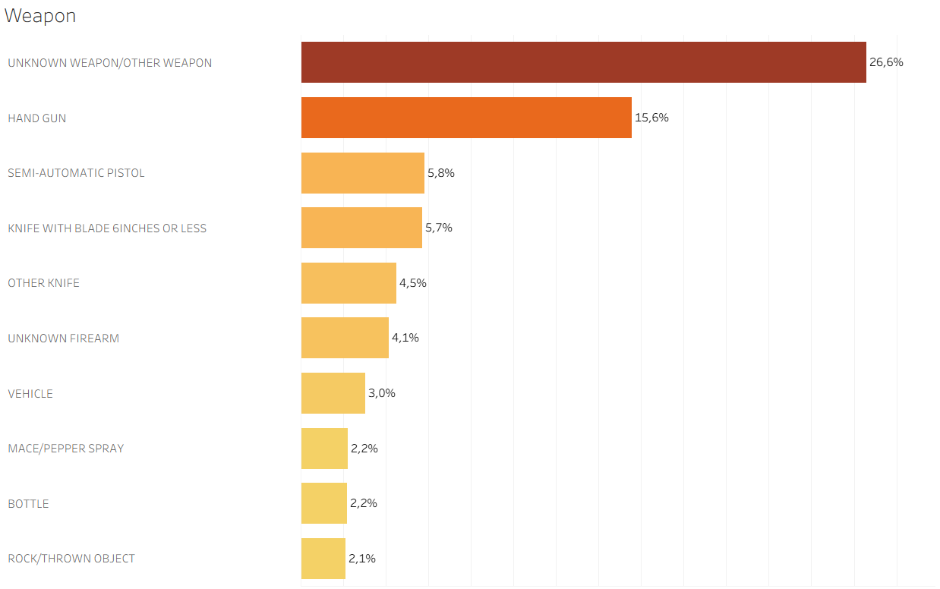
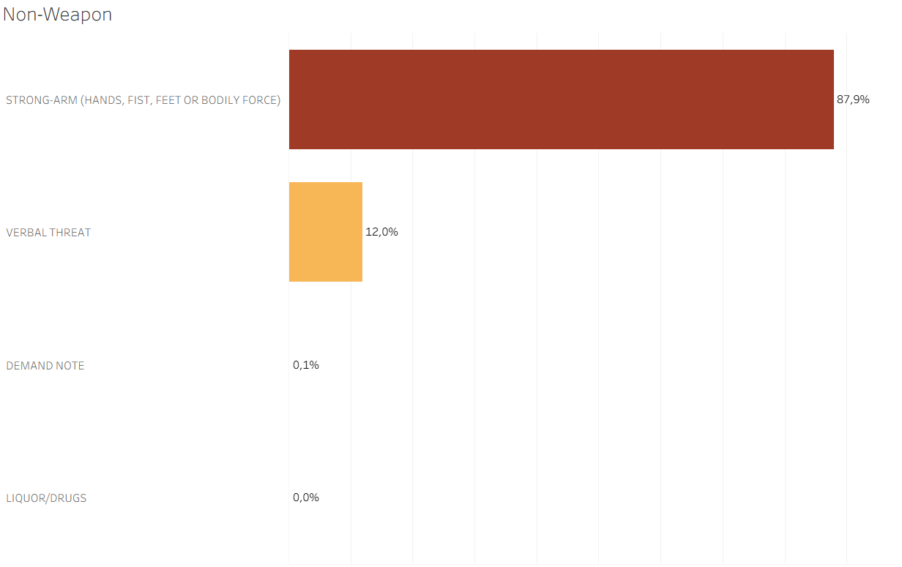
Weapon Usage Analysis

Slide 12
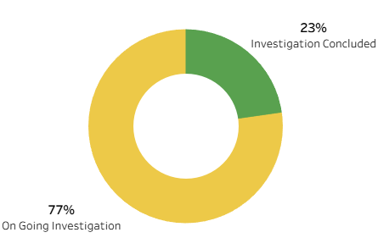
Crime Status Breakdown

Slide 13
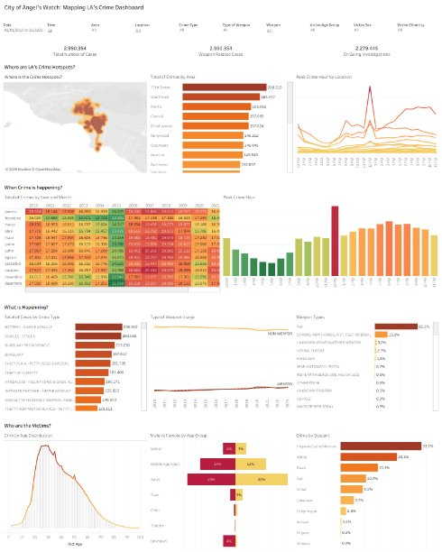
Dashboard

Slide 14
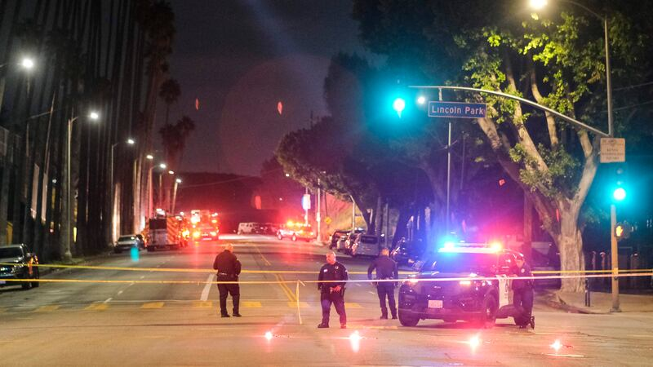
Recommendations
Increase patrols in identified hotspots.
Run awareness programs in high-crime residential zones.
Prioritize resolution of armed crimes.
Deploy real-time dashboards for faster decisions.

Slide 15
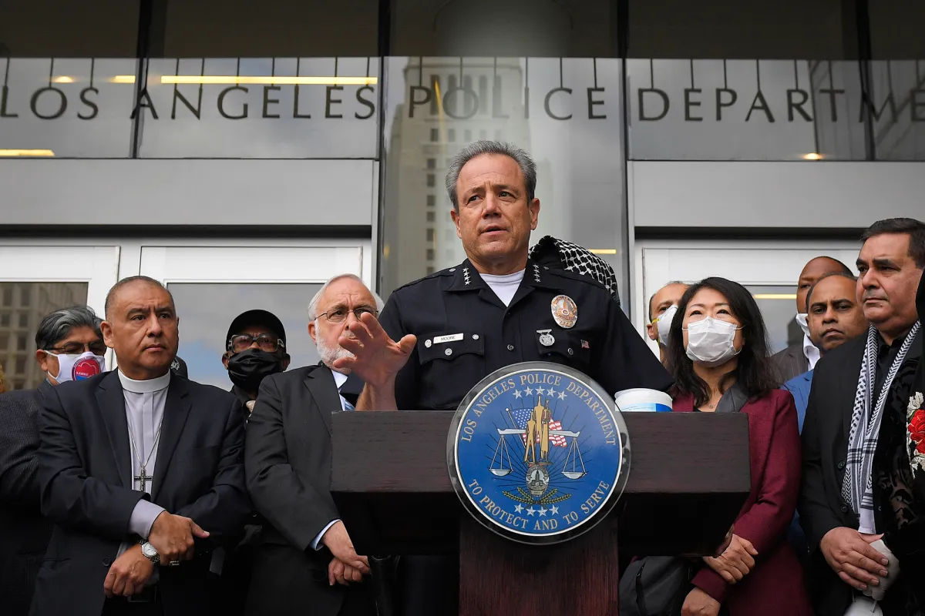
Conclusion
LAPD can leverage data for effective crime prevention.
Dashboards offer transparency and support informed policing.
Ongoing analysis ensures responsive and adaptive strategies.

Slide 16

Questions & Discussion

